Slide 1
Craig A. Hoffman| cahoffman@bakerlaw.com | @Craig_Hoffman Blog: www.dataprivacymonitor.com
August 9, 2013
What Business Owners Need to Know About Data Privacy

Slide 2
Agenda
Compliance Obligations
FTC Enforcement
Data Breach Notification Laws
Incident Response Best Practices
Legislative Updates

Slide 3
Compliance Obligations

Slide 4
Compliance Complexity
_{COMPLIANCE}
_{PCI-DSS}
_{HIPAA}
_{HITECH}
_{STATE}
_{PRIVACY LAWS}
_{(e.g. TX, CA)}
_{INTERNATIONAL DATA}
_{PROTECTION}
_{(e.g. EU, CANADA)}
_{FTC}
_{GLBA}
_{STATE BREACH}
_{NOTIFICATION}
_{LAWS}
INDUSTRY SELF REGULATION
SEC
DISCLOSURE
GUIDANCE

Slide 5
Interacting with Customers
Federal Law
•Computer Fraud and Abuse Act (18 U.S.C. §1030)
•Electronic Communications Privacy Act (18 U.S.C.§2510-2522)
Stored Communications Act (18 U.S.C. §§2701-12)
•Telephone Consumer Protection Act (47 U.S.C. §227)
•Video Privacy Protection Act (18 U.S.C. §2710)
•The CAN-SPAM Act (15 U.S.C. §7701 et seq.)
Fair Credit Reporting Act (15 U.S.C. § 1681 et seq).
•Children’s Online Privacy Protection Act (16 C.F.R. §312)
State Law
•Unfair competition
Spyware, Spam, & Do Not Call statutes
•“Shine the Light” Law (Cal. Civ. Code §1798.3)
•Song-Beverly Act of 1971 (Cal. Civ. Code §§1747-1748.7)
•Invasion of Privacy Act (Cal. Penal Code §630 et. seq.)
•Standards for the Protection of Personal Information (MA 201 CMR 17.01 et seq)

Slide 6
FTC Compliance Complexity
_{Section 5 FTC Act}
_{CAN-SPAM}
_{Do Not Track &}
_{Do Not Call}
Dot Com Disclosures / Testimonials & Endorsements
_{Fair Credit Reporting Act}
Children’s Online Privacy Protection Act
_{Gramm-Leach-Bliley Act}
_{Representations to Customers}

Slide 7
Enforcement Agency Trends - FTC
Website Privacy Policies
Big Data
Do Not Track & Dotcom Disclosures
Mobile Apps
COPPA
Location Based Services
Facial Recognition

Slide 8
FTC Enforcement - Wyndham
Wyndham disclosed three incidents of card data theft between April 2008 and January 2010.
The FTC requested information from Wyndham, and after production proposed a consent order.
Wyndham did not agree and the FTC brought an enforcement action alleging that Wyndham committed unfair and deceptive trade practices in violation of Section 5 of the FTC Act.
The representations supporting the FTC’s claims come from Wyndham’s privacy policy:
. . . We recognize the importance of protecting the privacy of individual-specific (personally identifiable) information collected about guests, callers to our central reservation centers, visitors to our Web sites, and members participating in our Loyalty Program (collectively, “Customers”). . . .
We safeguard our Customers’ personally identifiable information by using standard industry practices. Although “guaranteed security” does not exist on or off the Internet, we take commercially reasonable efforts to create and maintain “fire walls” and other appropriate safeguards to ensure that to the extent we control the Information, the Information is used only as authorized by us and consistent with this Policy, and that the Information is not improperly altered or destroyed.

Slide 9
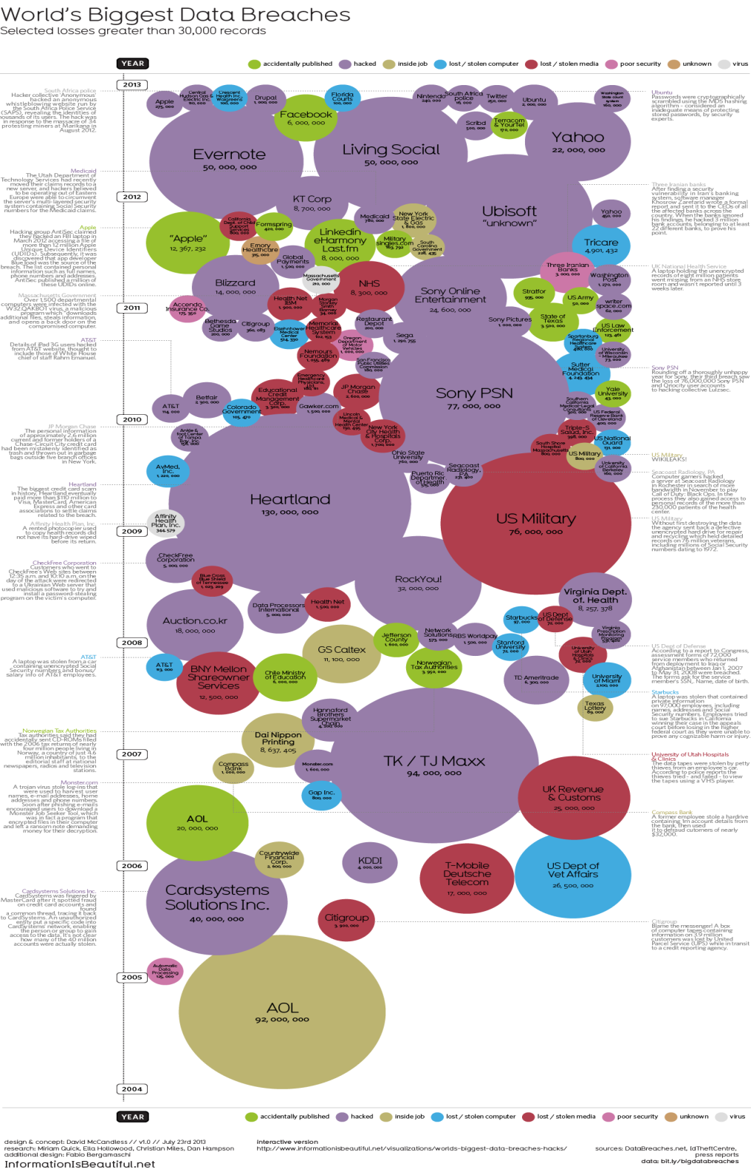
Breach Notification Laws

Slide 10
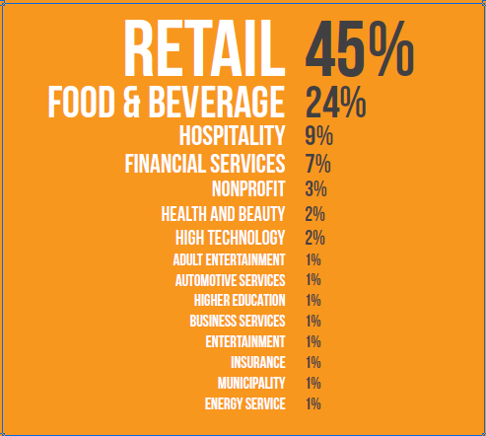
Breaches by Industry
Trustwave 2013 Global Security Report

Slide 11
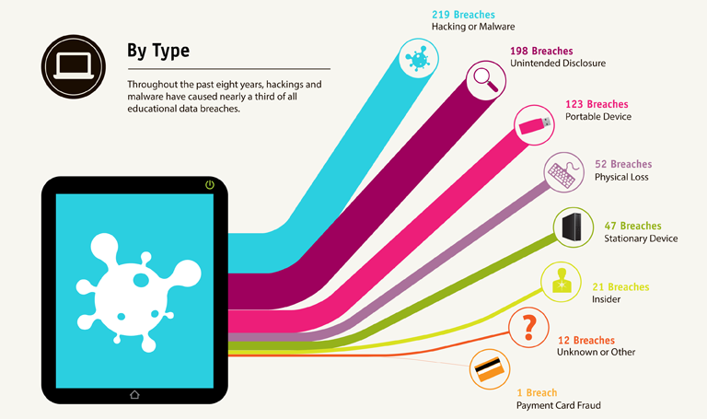
Causes of Breach
PrivacyRights.org

Slide 12
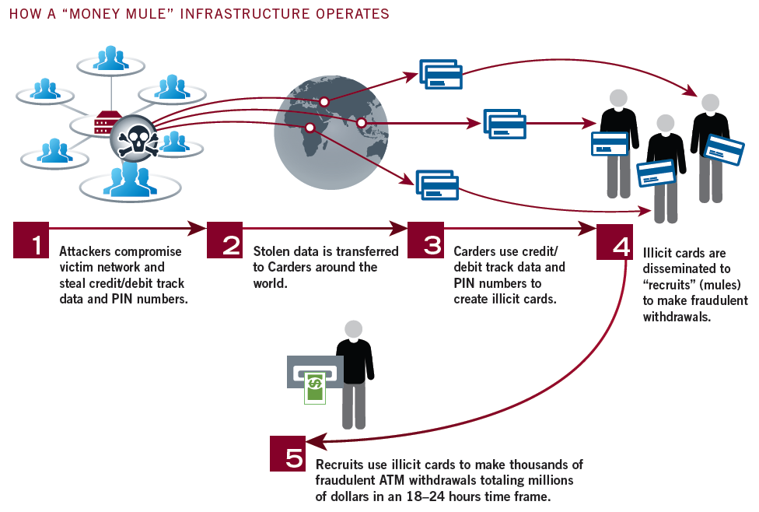
Mandiant M-Trends 2013 Security Threat Report

Slide 13
Basics of State Laws
All but four states have a breach notification law. The laws apply to a breach affecting “personal information.”
A breach is generally unauthorized access to or acquisition of personal information.
Most states have a “risk of harm” exception and a “safe harbor” if the data was encrypted.
Most require notification as soon as reasonably possible.

Slide 14
Ohio Law
“Personal information” is a name in combination with: (1) SSN, (2) driver’s license or state ID, or (3) account or payment card number along with a security code, access code, or password allowing access to individual’s financial account.
"Breach of the security of the system" means unauthorized access to and acquisition of computerized data that compromises the security or confidentiality of personal information owned or licensed by a person and that causes, reasonably is believed to have caused, or reasonably is believed will cause a material risk of identity theft or other fraud to the person or property of a resident of this state.
Breach notification required “in the most expedient time possible” but not later than 45 days after discovery.
State AG may bring enforcement action to seek a civil fine.

Slide 15
Costs of Response
Forensics
Notification costs
Credit monitoring
Call center
Crisis response
Legal fees
Defense costs/settlement expenses
PCI fines/assessments & regulatory fines

Slide 16
Incident Response Best Practices

Slide 17
Decisions, Decisions, Decisions
Is it a breach?
Do you involve law enforcement?
Do you hire a forensics company?
Do you retain counsel?
Do you involve regulatory agencies?
Is crisis management necessary?
Do you offer credit monitoring?
Do you get relief from a “law enforcement” delay?

Slide 18
Prepare
Cyber Liability Insurance
Written Information Security Policy
Incident Response Plan
Training & Education
Identify & Mitigate Risk
Manage Vendors

Slide 19
Commonalities of Breaches
Will be an external attack involving hacking and malware
Vulnerability created by third party vendor
Will not be detected for months
Breached entity will learn from third party
Initial exploit relatively simple and avoidable

Slide 20
Respond
Respond quickly
Bring in the right team
Preserve evidence
Contain & remediate
Let the forensics drive the decision-making
Law enforcement
Document analysis
Involve the C-suite
Be guarded, consistent, and honest in communications
Plan for likely reaction of customers, employees, & key stakeholders
Mitigate harm

Slide 21
SEC Guidance on Cyber-Security Disclosure Obligations
SEC Guidelines
Issued October 13, 2011
Suggests that publicly traded companies:
Disclose incidents of cyber intrusions in SEC filings
Disclose “risk factors” of cyber intrusions
SEC has issued letters requesting certain high-profile cyber intrusions be disclosed
Amazon’s Zappos.com breach
Google
Although not mandatory, SEC’s activity here seen as foreshadowing to future mandatory obligations

Slide 22
After the Breach
Regulatory inquiries and enforcement actions
Customer questions and demands
Lawsuits
Internal policy review

Slide 23
Legislative Update
Cybersecurity
Mandatory standards, info exchange, scope, liability protection
Executive Order & Presidential Directive
Consumer Privacy Bill of Rights
Codes of Conduct
Breach Notification
Electronic Communications Privacy Act
HIPAA Final Rule

